Slide 1
Human Computer Interaction
Dr/Amal Fouad

Slide 2
Lecture 1
Welcoming Lecture & Course Introduction

Slide 3
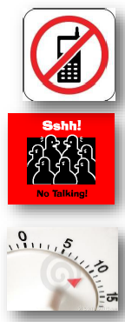
Lecture Rules
Cellular phones’ OFF
No side talking
No more than 10 min. delay

Slide 4
GRADING POLICY
̶ Assignments (5) ̶ Project ̶ Midterm ̶ Final Written Exam | 15% evaluated Assignments -3% per non-submitted assignment -1% per non-attended lab. 15% 20% 50 %
Notes:
•Computer Fundmental –Pradeep K. Sinha & Priti Sinha
•Introduction to Information Technologies -ITEC 1011 -YORK University

Slide 5
Policies
Re-marking.
̶ First, talk to the TA
̶ The TAs will hold a special remarking session shortly after assignments are handed back to
students.
̶ If you are still dissatisfied after talking to the TA, then email me to set up an appointment.
̶ You have up to 7 days from the time the marked assignment is available for hand-back to ask for a re-mark. No assignment will be re-marked after this period

Slide 6

Notes:
Hci is nice to have or can success the product or fail
Choose two things one you happy when you do and another you sad
Think why
هل هى ادت الوظيفه المطلوبه وكانت سهله التعلم و تفتكرها بسرعه

Slide 7
COURSE OBJECTIVES
Course Contents
What is HCI?
Interaction Design
User Interface Design rules
User Interface Evaluation
Research Frontiers

Slide 8
Course Contents
User Interface Evaluation
User Interface Design
Research Frontiers

Slide 9
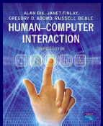

Course Material
Lecture slides
Books

Slide 10
HCI
Human Computer Interaction What is it?
One of the areas within computer science
the study, planning, and design of the interaction between
people (users) and computers
HCI Design is a mix of science, art & skill
Interdisciplinary
Areas include:
Input Devices
Output Devices
Interaction Techniques
Evaluation of Interfaces

Slide 11
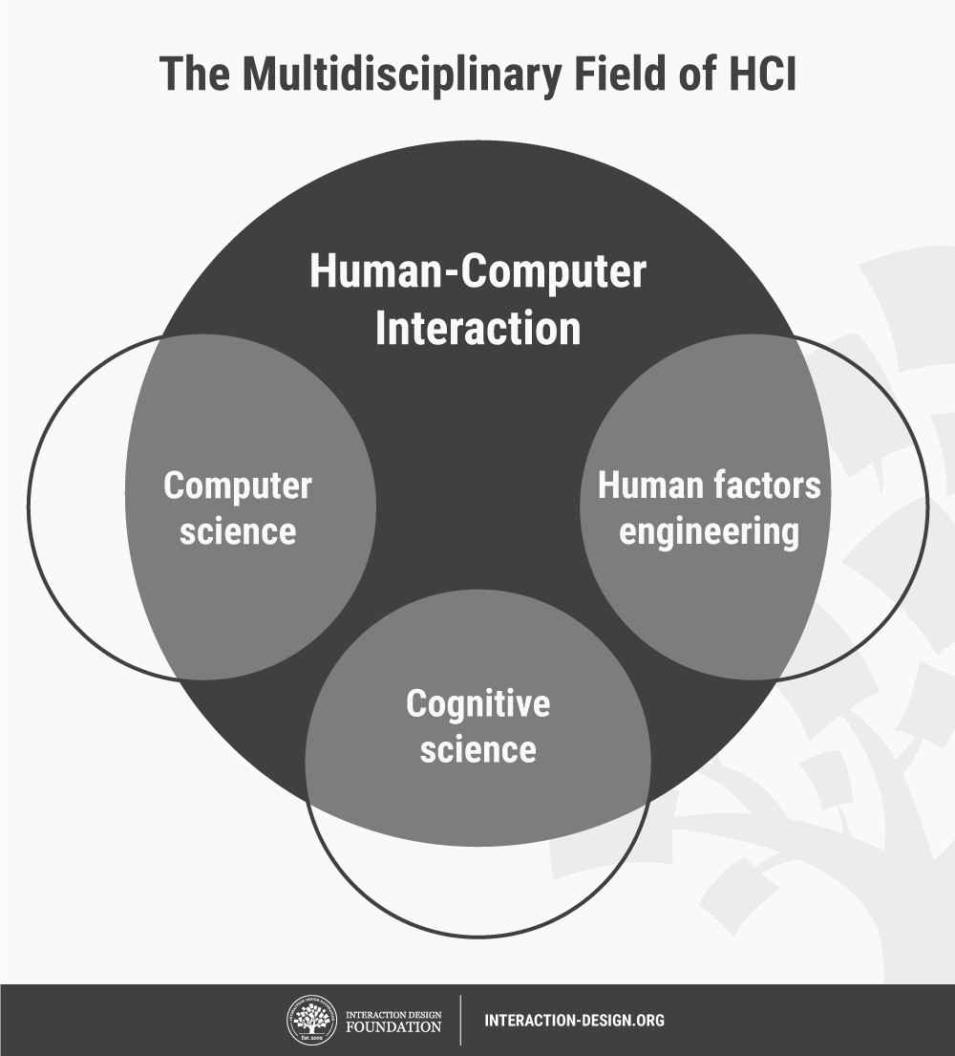
Human Computer Interaction
Human-Computer Interaction (HCI) is a multidisciplinary field of study focusing on the design of computer technology and, in particular, the interaction between humans (the users) and computers. While initially concerned with computers, HCI has since expanded to cover almost all forms of information technology design.

Slide 12
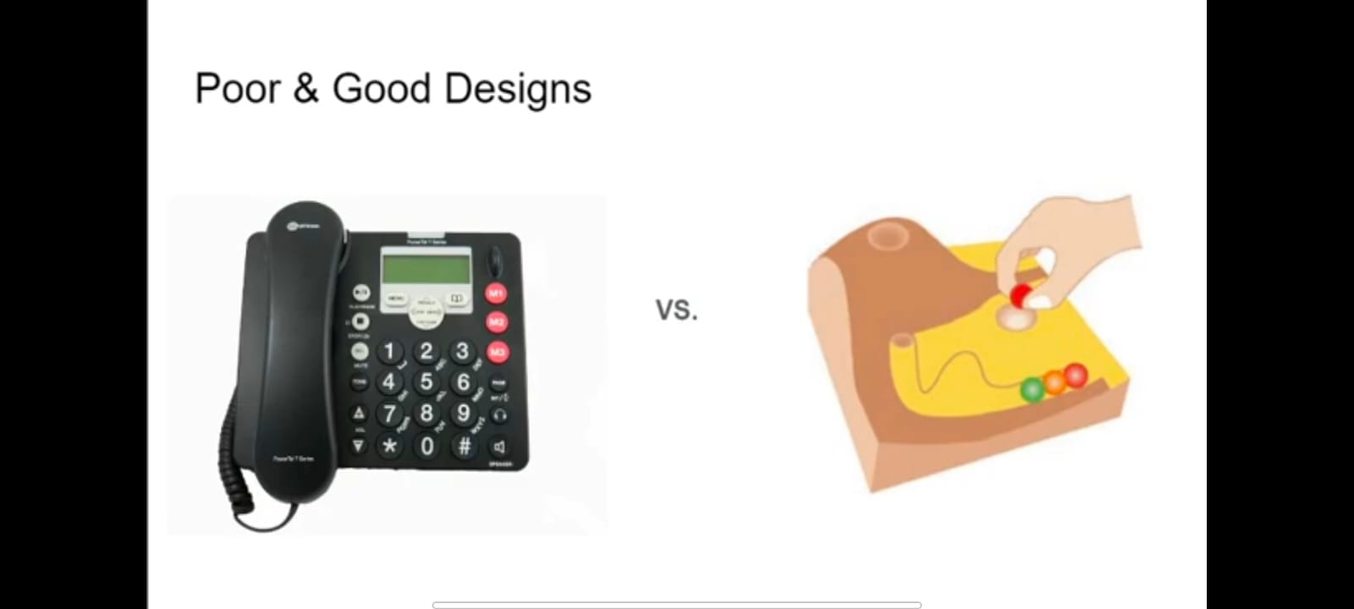
Poor & Good Design
Notes:
https://vimeo.com/183465991

Slide 13
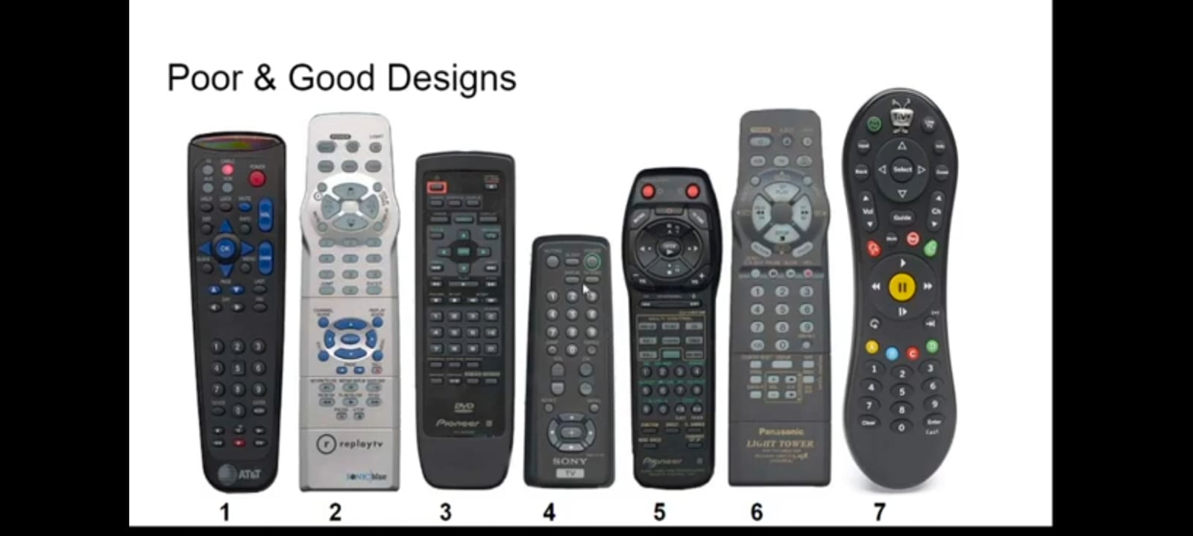
Poor & Good Design

Slide 14
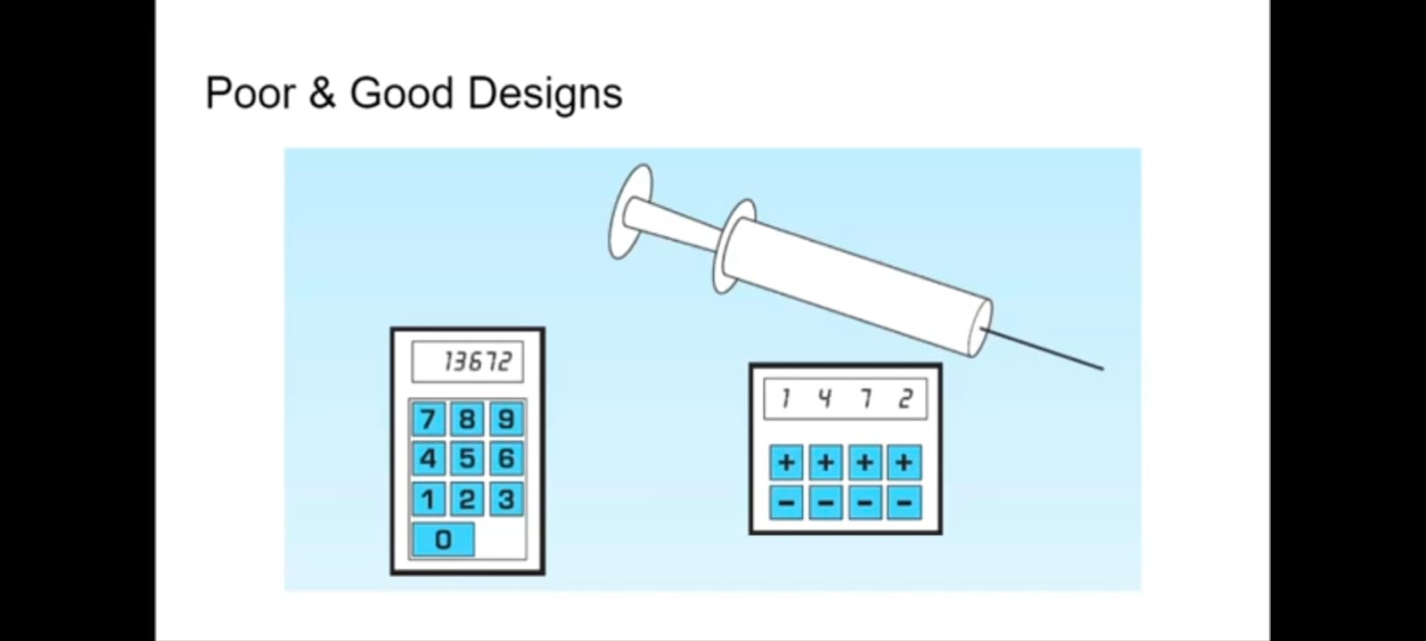
Poor & Good Design

Slide 15
Interactive Design
“Designing interactive products to support the way people communicate and interact in their everyday and working lives”
“The design of spaces for human communication and interaction”
How this is different from other methods such as “Software Engineering”?
Notes:
Civil Engineer vs Architect
Architect: Is there the right mix of family and private spaces? Are the spaces for cooking and eating in close proximity? Will people live in the space being designed in the way it was intended to be used?
Civil Engineer: Cost, durability, structural aspects, environmental aspects, fire regulations, and construction methods

Slide 16
Interactive Design
Listen ... Think ... Try ...
Who is going to be using?
How they are going to be used?
Where they are going to be used?
Goal: “Optimize the users’ interactions with a system, environment, or product, so that they support and extend the users’ activities in effective, pleasurable, useful, and usable ways”
Notes:
What people are good and bad at?
Listening to what people want
Using tried and tested user-based techniques

Slide 17
Interactive Design
Why?
Transforming human–human transactions into solely interface-based ones Examples: Self-checkouts at grocery stores, airports, and libraries
Extend the users’ activities in effective, pleasurable, useful, and usable ways Examples: cameras, microwave ovens, and washing machines
Notes:
Computer-based systems: send messages, gather information, write essays, control power plants, program, draw, plan, calculate, monitor others, play games
Interactive devices: multitouch displays, speech-based systems, handheld devices, and large interactive displays
Towards transforming human–human transactions into solely interface-based ones
Interfaces: cameras, microwave ovens, and washing machines, Self-checkouts at grocery stores, airports, and libraries

Slide 18
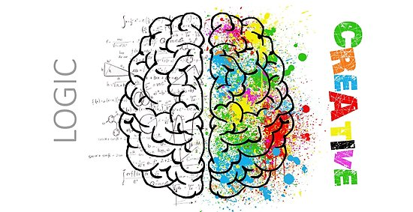
Who is involved
Developers
Understand
The business side,
The technical side,
The manufacturing side
Designers
How people act and react to events?
How they communicate and interact with each other?
How emotions work?
Create engaging user experience
How easy is it to work in multidisciplinary teams?
Notes:
Cost!?
The more people there are with different backgrounds in a design team, the more difficult it can be to communicate and make progress forward with the designs being generated

Slide 19
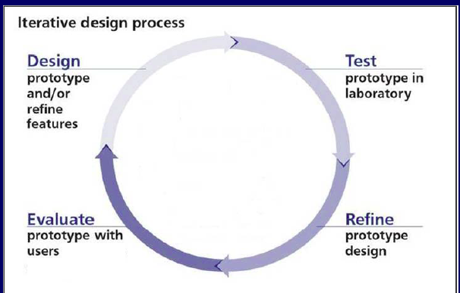
Design: an iterative process

Slide 20
User Experience (UX)
“How a product behaves and is used by people in the real world. How people feel about a product and their pleasure and satisfaction when using, looking at, holding, opening or closing it.”

Slide 21

User Experience (UX)
Every product that is used by someone has a user experience: newspapers, ketchup bottles, reclining armchairs, cardigan sweaters
Positive experiences drive curiosity. They help motivate us to grow as individuals.
Negative experiences help us prevent repeated mistakes.

Slide 22
User Experience (UX)
Watch the small details!!
How smoothly a switch rotates
The sound of a click
The touch of a button when pressing it
The colors selection
The weight of the device
….

Slide 23
User Experience (UX)
Factors of UX are
Usability
Functionality
Aesthetics / Look and feel
Content
Emotional appeal (Norman’s model: visceral, behavioral, reflective)

Slide 24
Norman’s model
Visceral Users’ gut reactions to or their first impressions of your design; e.g., an uncluttered user interface suggests ease of use.
Behavioral Users subconsciously evaluate how your design helps them achieve goals, and how easily. They should feel satisfied that they’re in control, with minimum effort required.
Reflective After they encounter your design, users will consciously judge its performance and benefits, including value for money. If they’re happy, they’ll keep using it, form emotional bonds with it and tell their friends.

Slide 25
Usability
“Ensuring that interactive products are easy to learn, effective to use, and enjoyable from the user’s perspective”
Usability Goals:
Effectiveness
Efficiency
Safety
Utility
Learnability
Memorability

Slide 26
Usability - Effectiveness
Doing The Right Things
How good a product is at doing what it is supposed to do?
Question: Is the product capable of allowing people to carry out their work, access the information they need, or buy the goods they want?

Slide 27
Usability - Efficiency
Doing Things Right
Refers to the way a product supports users in carrying out their tasks
Question: Once users have learned how to use a product to carry out their tasks, can they sustain a high level of productivity?
Examples:
Marble answering machine
Saving profiles in online system

Slide 28
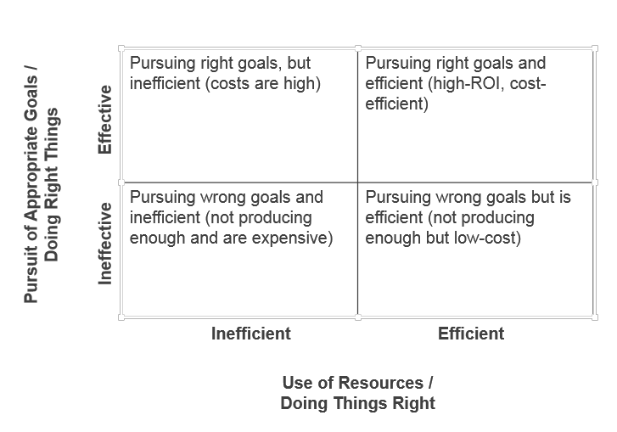

Slide 29
Usability - Safety
Protecting the user from dangerous conditions and undesirable situations
Question: What is the range of errors that are possible using the product and what measures are there to permit users to recover easily from them?
Examples:
Menu items positioning
Undo
Warning messages

Slide 30
Usability - Utility
Provides the right kind of functionality so that users can do what they need or want to do.
Question: Does the product provide an appropriate set of functions that will enable users to carry out all their tasks in the way they want to do them?
Examples:
Drawing tool without freenhand support
Remote control to move cursor

Slide 31
Usability - Learnability
How easy a system is to learn to use
Question: Is it possible for the user to work out how to use the product by exploring the interface and trying out certain actions? How hard will it be to learn the whole set of functions in this way? How long does it take?
Examples:
GPS
Autocad / Photoshop

Slide 32
Usability - Memorability
How easy a product is to remember how to use, once learned.
Question: What kinds of interface support have been provided to help users remember how to carry out tasks, especially for products and operations they use infrequently? What is the number of errors made when carrying out a given task over time?
Examples:
Menu items placement

Slide 33
Design Principles
Generalizable abstractions intended to orient designers towards thinking about different aspects of their designs.
Visibility
Feedback
Constraints
Mapping
Consistency
Affordance

Slide 34
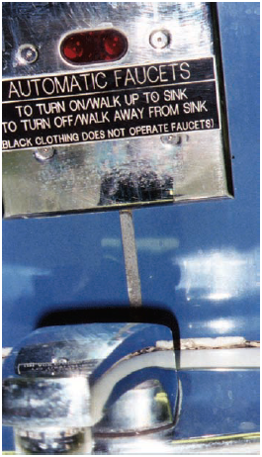
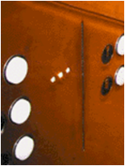
Design Principles
Generalizable abstractions intended to orient designers towards thinking about different aspects of their designs.
Visibility
Feedback
Constraints
Mapping
Consistency
Affordance

Slide 35
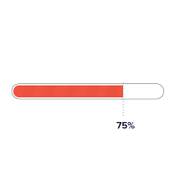
Design Principles
Generalizable abstractions intended to orient designers towards thinking about different aspects of their designs.
Visibility
Feedback
Constraints
Mapping
Consistency
Affordance

Slide 36
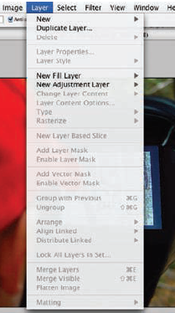
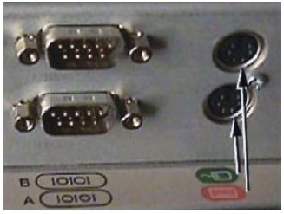
Design Principles
Generalizable abstractions intended to orient designers towards thinking about different aspects of their designs.
Visibility
Feedback
Constraints
Mapping
Consistency
Affordance

Slide 37

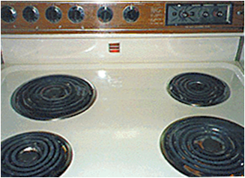
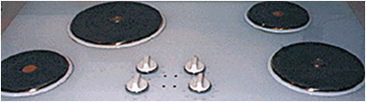
Design Principles
Generalizable abstractions intended to orient designers towards thinking about different aspects of their designs.
Visibility
Feedback
Constraints
Mapping
Consistency
Affordance

Slide 38
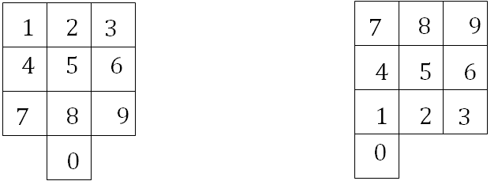
Design Principles
Generalizable abstractions intended to orient designers towards thinking about different aspects of their designs.
Visibility
Feedback
Constraints
Mapping
Consistency
Affordance
(a) phones, remote controls
(b) calculators, computer keypads

Slide 39
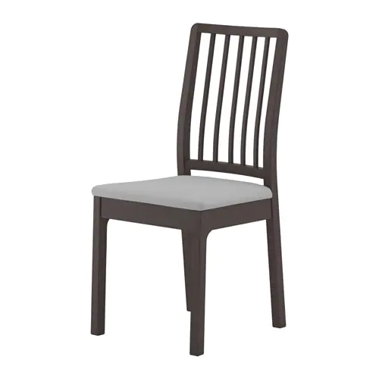

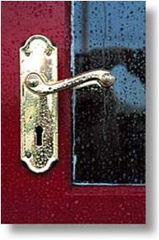
Design Principles
Generalizable abstractions intended to orient designers towards thinking about different aspects of their designs.
Visibility
Feedback
Constraints
Mapping
Consistency
Affordance (perceived and real)

Slide 40
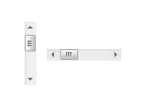


Design Principles
Generalizable abstractions intended to orient designers towards thinking about different aspects of their designs.
Visibility
Feedback
Constraints
Mapping
Consistency
Affordance (perceived and real)

Slide 41
Summary
Interactional Design
HCI
User Experience
Usability
Design Principles

